Slide 1
CSCI 566: Deep Learning and Its Applications
Jesse Thomason
Lecture 6: DL for Natural Language Processing

Slide 2
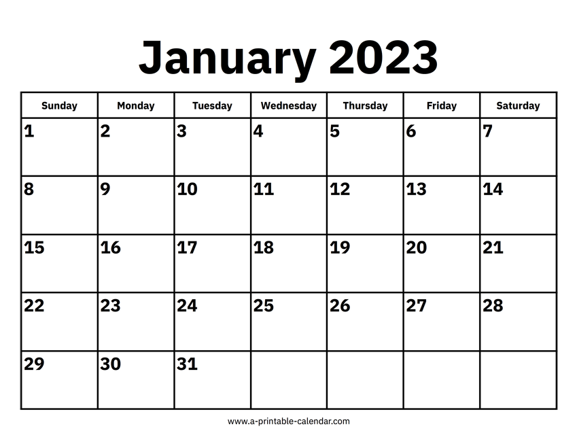
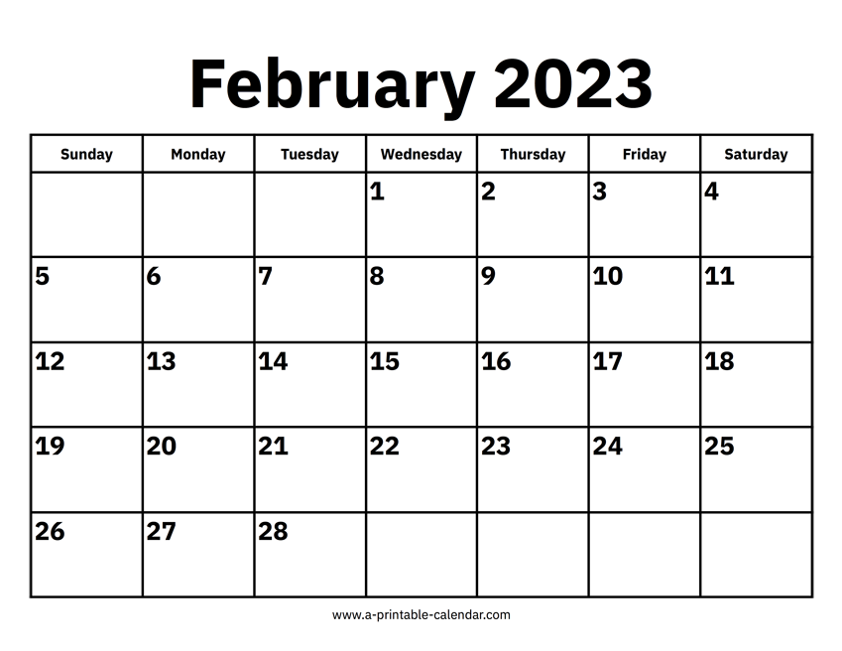
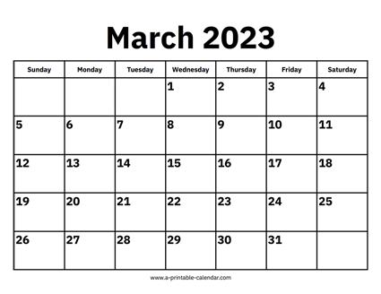
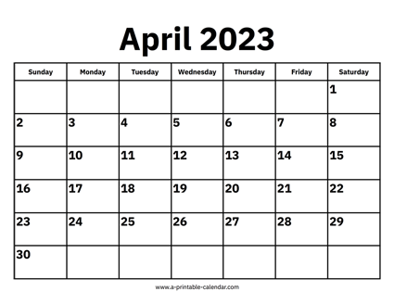


CSCI 566 Roadmap
Module 1: Neural Network Basics
Module 2: Deep Learning Applications
Module 3: Advanced Topics in Deep Learning

Slide 3
[Mar 3] March Deliverables
Project Pitch | Mar 3
Assignment 2 OUT | Mar 10
Project Survey Report | Mar 10
NO CLASS | Mar 17
Assignment 2 Due | Mar 24
Project Midterm Report | Mar 31

Slide 4
Assignment 1 Survey
“[Poll] How Long You Spent on Assignment 1”
https://piazza.com/class/lcpa44ep1pk5aj/post/196
Please fill this poll on Piazza; it’s in the pinned posts section
Since this is our first time running the class, we’re calibrating
For assignment 2, for weighting of coding assignment points versus exams/project/etc.

Slide 5
Survey Reports Due March 10 [Friday, 11:59pm]
A literature survey (e.g., "Related Work" section in a conference paper)
(1) What has been done related to your proposal?
This may comprise multiple paragraphs/sections of different related areas and efforts
(2) What are the limitations or challenges remaining to be solved?
What are the open questions? At least one of these should be what your project aims to address, though you should highlight others too.
Format: a 1.5-2 page (double-column) literature review write-up.
Additionally, a single page summary of contributions from each team member on your project.
Spell out your individual contributions clearly on that final page.

Slide 6
Midterm
The exam (primary and make-up versions) is still being graded
We will have an exam debrief session next class [Mar 10]
Will cover grade distribution, common mistakes, any changes to grading made post-release, etc.
Opportunity for Q&A for misunderstandings etc., but grades will be considered final at that time
Grades for the midterm (and assignment 1, etc.) will be posted to Blackboard

Slide 7
Midterm [Slide from Midterm Briefing; Feb 24; emph new]
The exam will be in the form of a link to a PDF (exam questions) and a link to a Google Form (to submit answers)
The exam is entirely multiple choice
The exam is open book / open note, but not open collaborator; please complete it on your own without assistance from other students or other agents
The exam PDF and Google Form will be available only during the 1:20pm-3:20pm window; links will go up on Piazza
I will hang out up here in case anything goes egregiously wrong or you find super confusing typos

Slide 8
Midterm
“please complete it on your own without assistance from other students or other agents”
If you are already aware that you violated this policy, please contact me so that we can work through the reporting procedures to the Office of Academic Integrity and the associated grade penalty
Else, I will be contacting you.

Slide 9
Project Pitches
If you haven’t added your slides to the main project pitch deck, please do so ASAP!
Pitches will take place in the last 1.25 hours of so of class
Main pitch deck link [here]
Do NOT overwrite other teams’ slides!
Your team name should be extremely visible on first slide

Slide 10
Overview of Today’s Plan
Course organization and deliverables
Any questions before we move on?
Recap from Lecture 5
Language Models and Word Embeddings
Project Pitches

Slide 11
Natural Language Processing in the Wild
Hype?
ChatGPT
Bing chat
Mundane but actually useful*?
Autocomplete
Grammar Corrections
Assistants: Google, Amazon Alexa, Apple Siri (well, *)

Slide 12

Classes of Sequence-to-Sequence Problems
One-to-one
One input produces one output
Image classification
y
h
Person
x

Slide 13
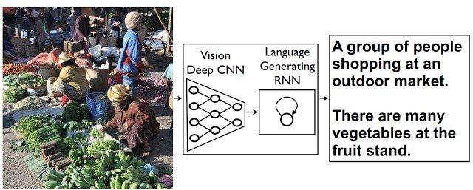
Classes of Sequence-to-Sequence Problems
One-to-many
One input produces a sequence of outputs
Image captioning
y₁
y₂
y₃
y₄
y₅
y_{n}
h₁
h₂
h₃
h₄
h₅
…
h_{n}
x

Slide 14
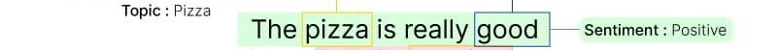
Classes of Sequence-to-Sequence Problems
Many-to-one
Sequence of inputs produces a single output
Text classification
y
h₁
h₂
h₃
h₄
h₅
…
h_{n}
x₁
x₂
x₃
x₄
x₅
x_{n}

Slide 15
Classes of Sequence-to-Sequence Problems
Many-to-many
A sequence of inputs produces a sequence of outputs
Robot Actions
y₁
y₂
y₃
y₄
y₅
y_{n}
h₁
h₂
h₃
h₄
h₅
…
h_{n}
x₁
x₂
x₃
x₄
x₅
x_{n}

Slide 16
Classes of Sequence-to-Sequence Problems
Many-to-many variants:
Sequential one-to-one
Robot actions
Encoder-decoder
Machine Translation
y₁
y₂
y₃
y₄
y₅
y₁
y₂
Encoder Network
h₁
h₂
h₃
h₄
h₅
h₁
h₂
h₃
Decoder Network
h₄
h₅
x₁
x₂
x₃
x₄
x₅
x₁
x₂
x₃

Slide 17
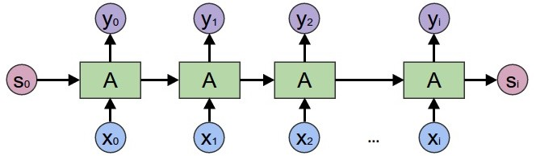
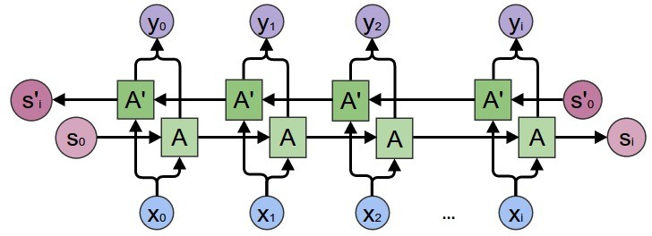
Unidirectional and Bidirectional Seq2Seq Models
Forward RNN
Bidirectional RNN
Output y_{t} depends only on inputs so far x_{0:t-1}
E.g., robot actions
Output y_{t} depends on all inputs x_{0:L}
E.g., machine translation

Slide 18
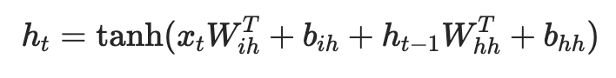
Text Classification with a Recurrent Neural Network
“Logits” for each of the |C| class labels
Fully Connected Layer F(h_{n})
RNN hidden state h
RNN
RNN
…
RNN
Embeddings E(t)
Embedding Layer E(t)
Token id t:
1
320
253
281
6
0
287
4
Word-level
served
cold
ice
cream
and
warm
pizza
.

Slide 19
Backpropagation for RNN
l₁=L(y₁, *y₁)
l₂=L(y₂, *y₂)
l₃=L(y₃, *y₃)
y₁
y₂
y₃
y₁=𝝈(W_{h→y}h₁)
y₂=𝝈(W_{h→y}h₂)
y₃=𝝈(W_{h→y}h₃)
h₀
h₁
h₂
h₃
h₁=tanh(W_{h→h}h₀+W_{x→h}x₁)
h₂=tanh(W_{h→h}h₁+W_{x→h}x₂)
h₃=tanh(W_{h→h}h₂+W_{x→h}x₃)
x₁
x₂
x₃

Slide 20
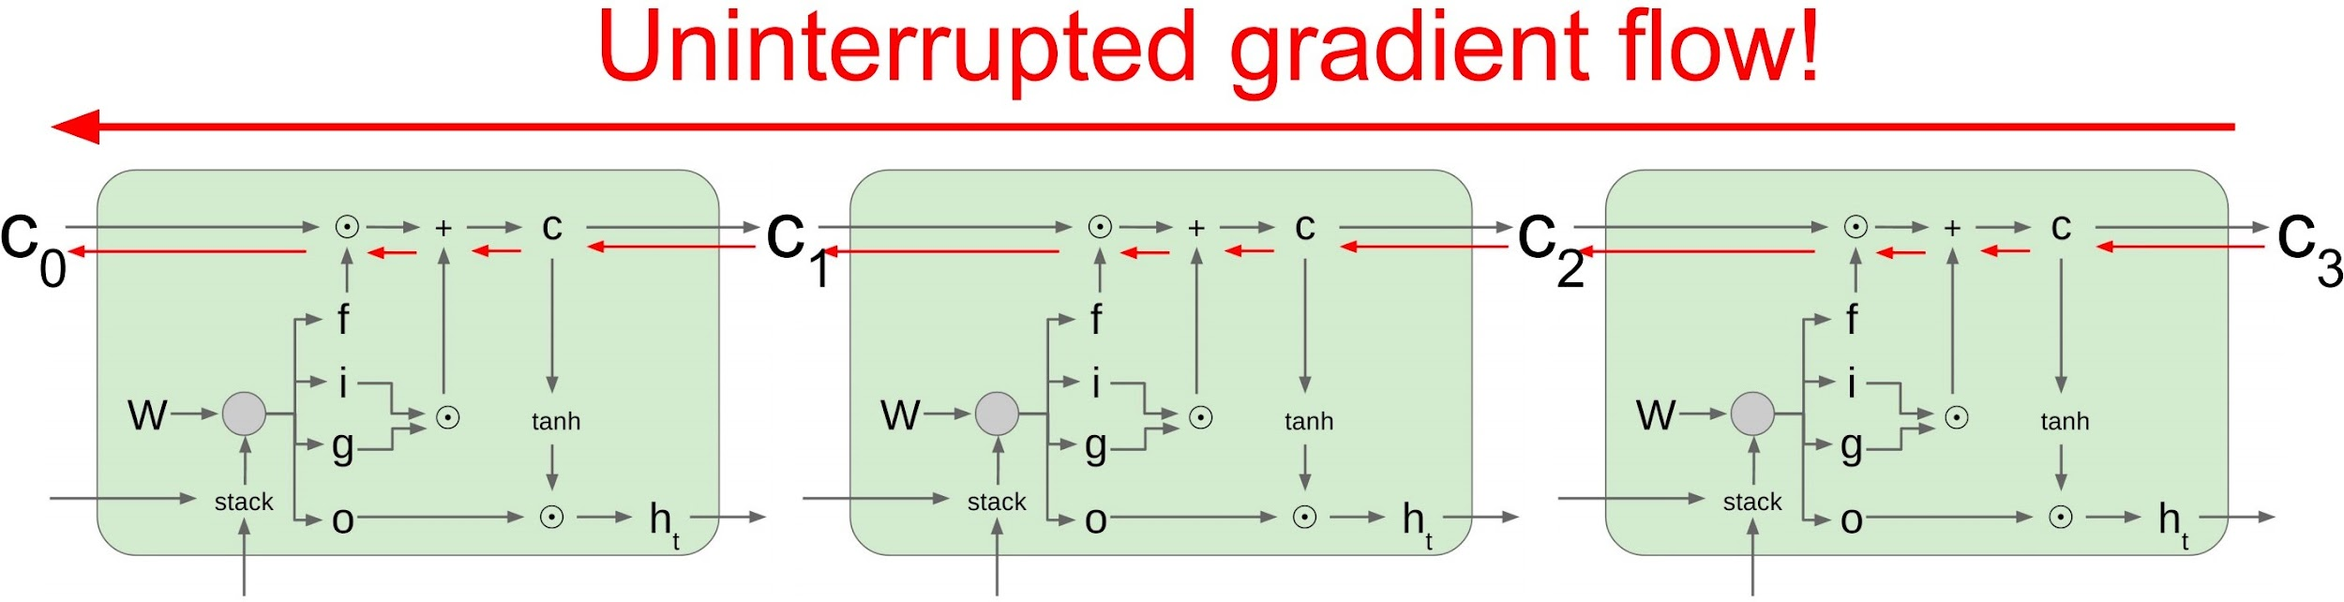
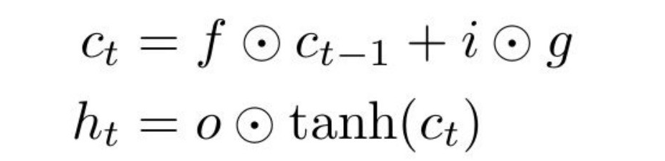
Long short-term memory

Slide 21
Machine Translation and The Case for Contextual Info
893
489
998
شجرتان
shajaratan
تتمايلان
tatamayalan
<E>
s(h_{d})
s(h_{d})
s(h_{d})
Decoder D hidden state h_{d}
RNN
RNN
RNN
RNN
RNN
RNN
RNN
RNN
Embedding Layer V_{d}(t)
999
893
489
<S>
شجرتان
shajaratan
تتمايلان
tatamayalan
Embedding Layer V_{e}(t)
999
128
137
783
998
<S>
two
trees
sway
<E>

Slide 22
Machine Translation and The Case for Contextual Info
893
شجرتان
shajaratan
s(h_{d})
Decoder D hidden state h_{d}
RNN
RNN
RNN
RNN
RNN
RNN
Embedding Layer V_{d}(t)
999
<S>
Embedding Layer V_{e}(t)
999
128
137
783
998
<S>
two
trees
sway
<E>

Slide 23
Use Attention to Rewrite RNN State Input
∈R
893
a=FC(h_{d1},h_{ei})
شجرتان
shajaratan
Σ_{i=1…L}h_{ei}exp(a(h_{d1},h_{ei}))
s(h_{d})
Init decoder D hidden state h_{d1}=h_{eN}
[Σ_{j=1…L}exp(a(h_{d1},h_{ej}))]
RNN
RNN
RNN
RNN
RNN
RNN
RNN
Embedding Layer V_{d}(t)
999
<S>
Embedding Layer V_{e}(t)
999
128
137
783
998
<S>
two
trees
sway
<E>

Slide 24
Attention
893
شجرتان
shajaratan
Σ_{i=1…L}h_{ei}exp(a(h_{d1},h_{ei}))
s(h_{d})
[Σ_{j=1…L}exp(a(h_{d1},h_{ej}))]
RNN
RNN
RNN
RNN
RNN
RNN
Embedding Layer V_{e}(t)
999
128
137
783
998
a=FC(h_{d1},h_{e1})
a=FC(h_{d1},h_{e2})
a=FC(h_{d1},h_{e3})
a=FC(h_{d1},h_{e4})
a=FC(h_{d1},h_{e5})
<S>
two
trees
sway
<E>

Slide 25
Attention
893
شجرتان
shajaratan
Σ_{i=1…L}h_{ei}exp(a(h_{d1},h_{ei}))
s(h_{d})
[Σ_{j=1…L}exp(a(h_{d1},h_{ej}))]
RNN
RNN
RNN
RNN
RNN
RNN
e
e
e
e
e
Σ
e
Σ
e
Σ
e
Σ
e
Σ
e
Embedding Layer V_{e}(t)
999
128
137
783
998
a=FC(h_{d1},h_{e1})
a=FC(h_{d1},h_{e2})
a=FC(h_{d1},h_{e3})
a=FC(h_{d1},h_{e4})
a=FC(h_{d1},h_{e5})
<S>
two
trees
sway
<E>

Slide 26
Multi-Headed Attention
893
h_{d2}=
شجرتان
shajaratan
Σ_{i=1…L}h_{ei}exp(a(h_{d1},h_{ei}))
s(h_{d})
[Σ_{j=1…L}exp(a(h_{d1},h_{ej}))]
RNN
RNN
RNN
RNN
RNN
RNN
e
e
e
e
e
Σ
e
Σ
e
Σ
e
Σ
e
Σ
e
Embedding Layer V_{e}(t)
999
128
137
783
998
a=FC(h_{d1},h_{e1})
a=FC(h_{d1},h_{e2})
a=FC(h_{d1},h_{e3})
a=FC(h_{d1},h_{e4})
a=FC(h_{d1},h_{e5})
<S>
two
trees
sway
<E>

Slide 27
Multi-Headed Attention
h_{d2}
893
h¹_{d2}=
Add+Norm
شجرتان
shajaratan
h²_{d2}=
Σ_{i=1…L}h_{ei}exp(a(h_{d1},h_{ei}))
s(h_{d})
[Σ_{j=1…L}exp(a(h_{d1},h_{ej}))]
RNN
RNN
RNN
RNN
RNN
RNN
e
e
e
e
e
e
e
e
e
e
Σ
e
Σ
e
Σ
e
Σ
e
Σ
e
Σ
e
Σ
e
Σ
e
Σ
e
Σ
e
Embedding Layer V_{e}(t)
999
128
137
783
998
998
a₂=FC(h_{d1},h_{e1})
a=FC(h_{d1},h_{e1})
a₂=FC(h_{d1},h_{e1})
a=FC(h_{d1},h_{e2})
a₂=FC(h_{d1},h_{e1})
a=FC(h_{d1},h_{e3})
a₂=FC(h_{d1},h_{e1})
a=FC(h_{d1},h_{e4})
a₂=FC(h_{d1},h_{e1})
a=FC(h_{d1},h_{e5})
<S>
two
trees
sway
<E>
<E>

Slide 28
Multi-Headed Attention
h_{d2}
h¹_{d2}=
Add+Norm
893
h²_{d2}=
شجرتان
shajaratan
h³_{d2}=
Σ_{i=1…L}h_{ei}exp(a(h_{d1},h_{ei}))
s(h_{d})
[Σ_{j=1…L}exp(a(h_{d1},h_{ej}))]
RNN
RNN
RNN
RNN
RNN
RNN
e
e
e
e
e
e
e
e
e
e
e
e
e
e
e
e
e
e
e
e
e
e
e
e
e
e
e
Σ
Σ
Σ
e
e
e
Σ
Σ
Σ
Σ
Σ
Σ
Σ
Σ
Σ
Σ
Σ
Σ
Embedding Layer V_{e}(t)
999
128
137
998
783
998
998
a₃=FC(h_{d1},h_{e1})
a₂=FC(h_{d1},h_{e1})
a₃=FC(h_{d1},h_{e1})
a=FC(h_{d1},h_{e1})
a₂=FC(h_{d1},h_{e1})
a₃=FC(h_{d1},h_{e1})
a=FC(h_{d1},h_{e2})
a₂=FC(h_{d1},h_{e1})
a₃=FC(h_{d1},h_{e1})
a=FC(h_{d1},h_{e3})
a₂=FC(h_{d1},h_{e1})
a₃=FC(h_{d1},h_{e1})
a=FC(h_{d1},h_{e4})
a₂=FC(h_{d1},h_{e1})
a=FC(h_{d1},h_{e5})
<S>
two
trees
<E>
sway
<E>
<E>

Slide 29
Overview of Today’s Plan
Course organization and deliverables
Recap from Lecture 5
Any questions before we move on?
Language Models and Word Embeddings
Project Pitches

Slide 30
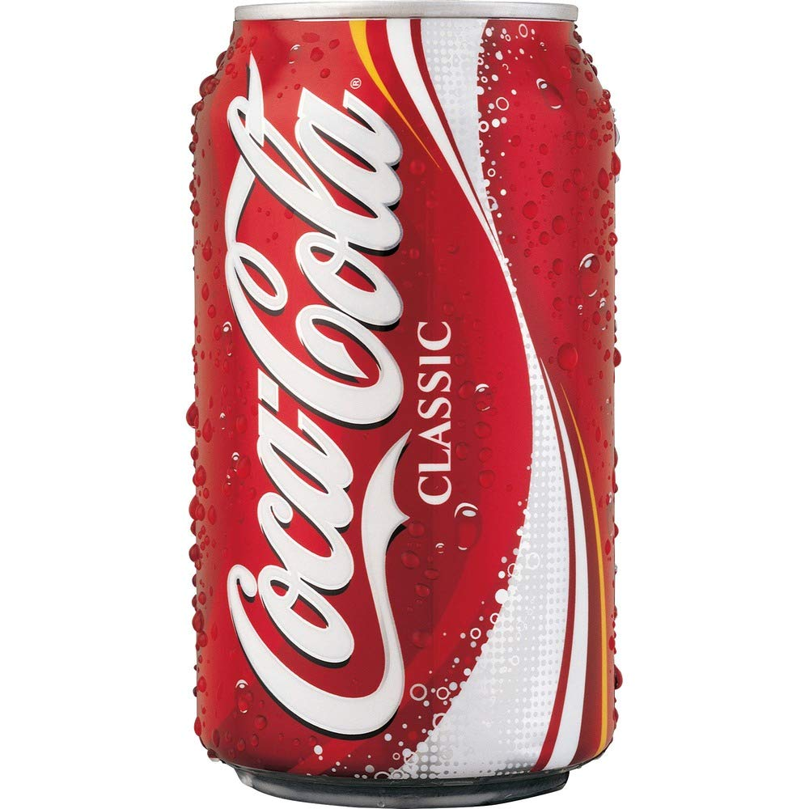
NLP FUNDAMENTALS: Language Models
A language model is an estimate of the likelihood of a string
Tokenizing the string into component parts is necessary
So we can consider a string s as a sequence of tokens w₁…w_{n}
Then a language model estimates:
p(s) = p(w₁…w_{n})
Term is overloaded; also used these days to mean:
p(w_{k}|w₁…w_{k-1}) — (e.g., auto-regressive)
p(w_{k}|w₁…w_{k-1}w_{k+1}…w_{n}) — (e.g., cloze / MLM)

Slide 31
N-gram language models
If we factor a string into words w_{i}, then
p(s) = p(w₁…w_{n})
= p(w_{n}|w₁…w_{n-1})p(w₁…w_{n-1})
In other words, the probability of the next word is equal to its chance given the words seen so far compounded by the likelihood of that sequence of words at all
What would it take to store p(w_{n}|w₁…w_{n-1}) on disk?

Slide 32
N-gram language models
How could we efficiently estimate p(w_{n}|w₁…w_{n-1})?
Independence assumptions!
Does a word k away in the history really affect what word comes next that much? What if we assume:
p(w_{n}|w₁…w_{n-1}) ≈ p(w_{n}|w_{n-k+1}…w_{n-1})
Then if we say “a word 4 away in the history does not affect me”, then p(w_{n}|w₁…w_{n-1}) ≈ p(w_{n}|w_{n-3}w_{n-2}w_{n-1})
How big on disk?
|V|*|V|*|V|*|V| = |V|⁴

Slide 33
N-gram language models
k=3, trigram LM
p(w_{n}|w₁…w_{n-1}) ≈ p(w_{n}|w_{n-2}w_{n-1})
|V|*|V|*|V| = |V|³
k=2, bigram LM
p(w_{n}|w₁…w_{n-1}) ≈ p(w_{n}|w_{n-1})
|V|*|V| = |V|²
k=1, unigram LM
p(w_{n}|w₁…w_{n-1}) ≈ p(w_{n})
|V|

Slide 34
Bigram Co-occurrence matrix
Count(w_{i}|w_{i-1})
w_{i} / w_{i-1} | the | students | learned | about | word | vectors | today | in | class
the | 0 | 0 | 0.05 | 0.1 | 0 | 0 | 0.05 | 0.1 | 0
students | 0.1 | 0 | 0 | 0.1 | 0 | 0 | 0.05 | 0.05 | 0
learned | 0 | 0.2 | 0 | 0 | 0.05 | 0.05 | 0.05 | 0 | 0.2
about | 0 | 0.05 | 0.2 | 0 | 0 | 0.05 | 0.1 | 0.2 | 0.1
word | 0.1 | 0 | 0.1 | 0.1 | 0 | 0 | 0.05 | 0.05 | 0
vectors | 0.1 | 0 | 0.2 | 0.2 | 0.4 | 0 | 0.05 | 0.05 | 0
today | 0 | 0.05 | 0.1 | 0 | 0 | 0 | 0 | 0.05 | 0.05
in | 0 | 0.1 | 0.1 | 0.05 | 0.05 | 0.05 | 0.2 | 0 | 0.05
class | 0.1 | 0 | 0.05 | 0.1 | 0.05 | 0 | 0 | 0.2 | 0

Slide 35
f: X ✕ Θ → Y;
f(x;θ)=y; θ∈Θ for model M
f: X → Y;
f(x)=y
f: ɸ_{x}(X) ✕ Θ → ɸ_{y}(Y);
f(x;θ)=y
f: ɸ_{x}(X) → ɸ_{y}(Y);
f(x)=y
DL enables function approximation for f and is constrained by:
Data representation ɸ
Model architecture M
Loss function L
Optimization algorithm
Training data D
θ*=min_{θ∈Θ}(Σ_{(x,y)}L(f(x;θ), y)))
θ*=min_{θ∈Θ}(Σ_{(x,y)∈D}L(f(x;θ), y)))

Slide 36
Text Representation
We need to define the encoding function, ɸ(x)=x for string x
Our encoding function will map raw strings to input features for the model M
How can we represent text?
x=“A tropical bird perches in the jungle.”
x is a sequence of characters, if we think about underlying data and the representation it takes in the machine.
When we think about language, do we think in sequences of characters?
What might be helpful for a model to reason about?

Slide 37
Feature Extraction for Language - Tokenization
D: image captions x that describe class label object l
“A tropical bird perches in the jungle.”
Word-level
a
tropical
bird
perches
in
the
jungle
.
We can break x up into the words and punctuation in it.
We’ll consider some alternatives shortly, but let’s take notes on what this choice gets us:
Can we can learn parameters of M that represent every word (i.e., word embeddings)?
Only “yes” if we can fit θ on disk, which requires θ to be at least finite, preferably also not exponential.

Slide 38
Feature Extraction for Language - Tokenization
“The year is 2032. A model was trained on all images, videos and text on the web, using over 100 yottaFLOPs..”
Word-level
…
using
over
Do we want a token representing the “word” 100?
We’ll have to learn individual embeddings for 0, 1, 2, …
Do we want a token representing the “word” yottaFLOPs?
Unlikely we’ll ever see this word again!
What if we find a way to ignore infrequent words?
How many words are “infrequent”?
https://twitter.com/gabriel_ilharco/status/1558079922026921985?s=20&t=L9uvSHaczZX1fPc7TDE3ww

Slide 39
Zipf’s Law
“an empirical law formulated using mathematical statistics that refers to the fact that for many types of data studied in the physical and social sciences, the rank-frequency distribution is an inverse relation.”
The frequency of words in natural language is often assumed to follow a Zipfian distribution
https://en.wikipedia.org/wiki/Zipf%27s_law

Slide 40
Zipf’s Law
“Zipf's law was originally formulated in terms of quantitative linguistics
The frequency of any word is inversely proportional to its rank in the frequency table.
Thus the most frequent word will occur approximately twice as often as the second most frequent word, three times as often as the third most frequent word, etc.”
https://en.wikipedia.org/wiki/Zipf%27s_law

Slide 41
Feature Extraction for Language - Tokenization
“The year is 2032. A model was trained on all images, videos and text on the web, using over 100 yottaFLOPs..”
Word-level
…
using
over
100
UNK
.
.
We count all the tokens in D_{train} and sort them by frequency
Keep the top-k most common tokens
What about everything else?
We can have a catch-all unknown (UNK) token with its own learnable representation
In other words: we make it the model’s problem.
https://twitter.com/gabriel_ilharco/status/1558079922026921985?s=20&t=L9uvSHaczZX1fPc7TDE3ww

Slide 42
Feature Extraction for Language - Tokenization
“A tropical bird perches in the jungle.”
+ Easy
- Sparse
|V|=|W| 💀
UNK!
Word-level
A
tropical
bird
perches
in
the
jungle
.
+ Less sparse
- Lossy (POS)
|V|=c|W| 💀
UNK!
Stemming
A
tropic
bird
perch
in
the
jungl
.
BPE
+ Denser
- Lossy
- Inconsistent
|V|=k
UNK possible
A
tropic
##al
bird
per
##ch
##es
in
the
jung
##le
.
+ Super dense
+ Consistent
- Onus on model
|V|=k
UNK preventable
Character
A
t
r
o
p
i
c
a
l
b
i
r
d
p
e
r
c
h
e
s
…

Slide 43
Tokenization and Batching
1
320
253
281
6
0
287
4
a
tropical
bird
perches
in
the
jungle
.
1
490
322
163
4
?
a
small
white
fox
.
Mini-Batch
0
330
261
8
1
1000
741
18
the
orange
spider
on
a
UNK
leaf
is
82
189
?
big
elephant
…

Slide 44
Tokenization and Batching
1
320
253
281
6
0
287
4
a
tropical
bird
perches
in
the
jungle
.
1
490
322
163
4
999
999
999
a
small
white
fox
.
PAD
PAD
PAD
Mini-Batch
0
330
261
8
1
1000
741
18
?
the
orange
spider
on
a
UNK
leaf
is
82
189
999
999
999
999
999
999
big
elephant
PAD
PAD
PAD
PAD
PAD
PAD
Padding Tokens
…

Slide 45
Tokenization and Batching
Sequence Start/End Tokens
997
1
320
253
281
6
0
287
4
998
START
a
tropical
bird
perches
in
the
jungle
.
END
997
1
490
322
163
4
998
999
999
999
START
a
small
white
fox
.
END
PAD
PAD
PAD
Mini-Batch
997
0
330
261
8
1
1000
741
18
475
START
the
orange
spider
on
a
UNK
leaf
is
sitting
997
82
189
4
998
999
999
999
999
999
START
big
elephant
.
END
PAD
PAD
PAD
PAD
PAD
Padding Tokens
…

Slide 46
NLP FUNDAMENTALS: Word Embeddings
A word embedding is a vector representation of a word
Word embeddings can be learned for specific tasks (e.g., our book classification task) or from self-supervised objectives
“You shall know a word by the company it keeps” - Firth
The guiding principle of many learned word embeddings is that two words who share similar context should have embeddings that are close together in vector space
J.R. Firth. A synopsis of linguistic theory. Studies in linguistic analysis, Blackwell, Oxford (1957)

Slide 47
Simplest option: Co-occurrence matrix
Let’s given each word w a vector of dimension |V| that represents the distribution of words that occur nearby to w
Co-occurrence:
Left context: what words occur before this one
Right context: what words occur after this one
Bidirectional context: what words occur on either side
Context length: how far do we look away from w?
Shorter context: word vectors favor syntax
Longer context: word vectors favor semantics/topic

Slide 48
n-Gram Model
An n-gram model represents the context of each word w as its co-occurrence with other words 1-, 2-, …, n-1-steps away
n-Grams are based on rigid, explicit counting, plus some smoothing to relax that rigidity
How else could we relax p(w_{i}|w_{i-1}w_{i-2}…w_{i-n+1}) ?
Previously, we kept a |V| count for each distance i-k
We could just keep a |V| count that merges distances
“Bag of Words”-based model

Slide 49
Bag-of-Words Model
Estimate p(w_{i}|w_{i-1}w_{i-2}…w_{i-n+1}) as distribution of w_{i} given that w_{i-1}w_{i-2}…w_{i-n+1} occur in any order left of w_{i}
Pros:
Space to store this model is |V|²
Model will be considerably less sparse
Cons:
Loss of order information will hurt POS guessing / syntax generally
Because the context from which we predict w_{i} is now a single vector, what other interesting information is here?

Slide 50
Bag-of-Words Model
We’ve been thinking about LM from just one perspective
“What next token is likely given the context so far?”
We could ask something else…
“What context will make a particular token most likely?”
Gives us a sense of which tokens are similar based on sharing similar favored contexts that produce them!
“You shall know a word by the company it keeps.”

Slide 51
Vectors Representing Context
What context will make a particular token w=a most likely?
argmax_{w(i-k)∊V}(p(w_{i}=a|w_{i-1}w_{i-2}…w_{i-n+1}))
Let’s apply Bayes’ Theorem:
p(a|w_{i-1}w_{i-2}…w_{i-n+1})
= p(w_{i-1}w_{i-2}…w_{i-n+1}|a)p(a) / p(w_{i-1}w_{i-2}…w_{i-n+1})
Then we want:
argmax_{w(i-k)∊V}(p(w_{i-1}w_{i-2}…w_{i-n+1}|a)p(a) / p(w_{i-1}w_{i-2}…w_{i-n+1}))
argmax_{w(i-k)∊V}(p(w_{i-1}w_{i-2}…w_{i-n+1}|a) / p(w_{i-1}w_{i-2}…w_{i-n+1}))
The context that maximizes the chance token a comes next is the likelihood of the context given a by the marginal probability of the context itself

Slide 52
Vectors Representing Context
Let’s consider a bigram model:
argmax_{w(i-1)∊V}(p(w_{i-1}|a) / p(w_{i-1}))
Intuitively: the word that frequently occurs before the target word a, and seldom occurring without a
If our context is a multi-hot vector instead of a one-hot vector, the intuition is the same, just for the last few words
Could we have reasoned about likely context in our n-gram models that considered word order?
Yes! Just even less tractable. |V|^{n-1} places to reason about.

Slide 53
Vectors Representing Context
The core unsatisfying thing about n-grams:
Sparsity!
Zipf’s law!
Zero entries dominate as context (n) grows
Using a multi-hot context of size |V| for previous n words (our bag-of-words alternative) does not resolve this fundamental issue because it’s based on co-occurrence counts yet

Slide 54
Word Embeddings Compress n-grams!
What is the standard remedy for sparsity in a data structure?
Compression!
What we would like to achieve is to compress all the co-occurrence information in our big table of word/context counts in fewer than |V|^{n} dimensions
Luckily, we can
The first neural approaches to achieving this goal stored |V|=30k, n=10 with bidirectional context in 600d vectors
Raw co-occurrence: 30,000¹⁰
Three hundred trillion entries in co-occ matrix

Slide 55
Word Embeddings: A dense alternative to sparse n-grams
The first neural word embeddings learning paper to gain traction:
Efficient Estimation of Word Representations in Vector Space. Tomas Mikolov, Kai Chen, Greg Corrado, Jeffrey Dean. International Conference on Learning Representations (ICLR), 2013.
Popularly known as?
Word2Vec

Slide 56
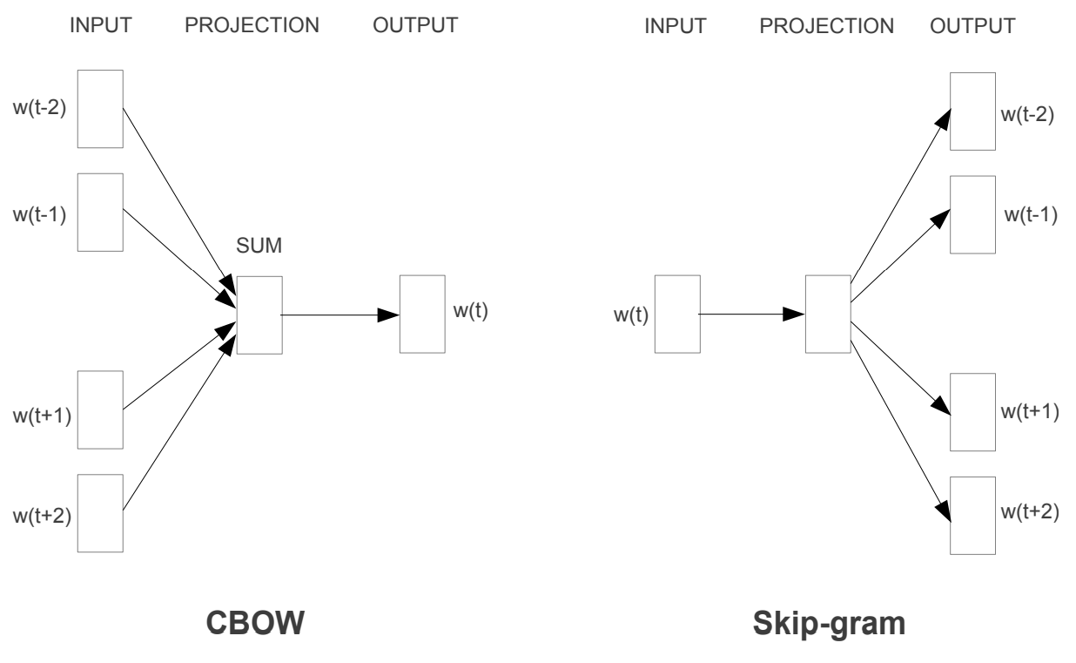
Word2Vec Proposed Two Models

Slide 57
Word2Vec: Continuous Bag-of-Words (CBOW)
What probability does the FC layer estimate?
p(w_{i}|w_{i-2}w_{i-1}w_{i+1}w_{i+2})
What assumptions?
Word order doesn’t matter
Firth!
What’s being learned?
FC + Embeddings
253
happy
Fully Connected Layer
Sum
Embedding Layer V_{e}(t)
999
320
780
998
<S>
i’m
today
<E>

Slide 58
Word2Vec: Continuous Skip-Gram Model
What probability does the FC layer estimate?
p(w_{i-2}|w_{i})p(w_{i-1}|w_{i})* p(w_{i+1}|w_{i})p(w_{i+2}|w_{i})
What assumptions?
Word order doesn’t matter
Firth!
What’s being learned?
FC + Embeddings
999
320
780
998
<S>
i’m
today
<E>
Fully Connected Layer
Embedding V_{e}(t)
253
happy

Slide 59
ML FUNDAMENTALS: Cross Entropies
253
Categorical cross entropy:
For F(x)->|C|, each x has label c*∊C; F(x) estimates p(c|x), and the loss encourages p(c*|x)=1
happy
Say which one of |C| labels x exhibits
Fully Connected Layer
Binary cross entropy:
For F(x)->|C|, each x has a combination of labels c_{k}∊C; F(x) estimates p(c|x), and the loss encourages p(c_{k}|x)=1
For each |C| say whether x exhibits it
999
320
780
998
<S>
i’m
today
<E>
Fully Connected Layer
Categorical Cross Entropy; Binary Cross Entropy

Slide 60
Word2Vec: Recap
253
999
320
780
998
happy
<S>
i’m
today
<E>
Fully Connected Layer
Fully Connected Layer
Sum
Embedding V_{e}(t)
253
happy
Embedding Layer V_{e}(t)
Skip-Gram; p(w_{i-2}|w_{i})p(w_{i-1}|w_{i})p(w_{i+1}|w_{i})p(w_{i+2}|w_{i})
999
320
780
998
<S>
i’m
today
<E>
CBOW; p(w_{i}|{w_{i-2}w_{i-1}w_{i+1}w_{i+2}})

Slide 61
Why Learn Word Embeddings from Language Modeling?
The techniques we’ve shown in this lecture learn word embeddings V as a side-effect of:
estimating p(w|c), which is itself a way to estimate:
p(s), the fundamental function of a language model
How else could we learn word embeddings?
Any task! E.g., in text classification or machine translation we can have learnable embedding layers
So why do we bother learning word embeddings via LM?
DATA: LM objectives are unsupervised! Only x given; we construct “fake” tasks out of x to create pairs

Slide 62
Why Learn Word Embeddings from Language Modeling?
The key is in the bane of NLP:
The curse of dimensionality
Word embeddings are a form of dimensionality reduction: instead of reasoning about |V| (or worse, all “possible” words), we reason about vectors of fixed dimension
It’s easier to learn when your data isn’t extremely sparse
Why would the word embeddings we learn as a side-effect of language modeling be beneficial downstream?
Word embeddings make co-occurrence less sparse for estimating the mutual information between inputs and outputs

Slide 63
Word Embeddings: What are We Actually Learning?
A language model is ultimately performing compression of the co-occurrence matrix
Consider, what would we expect for each case?
999
320
780
998
Embedding vector size:
|V| ?
Indicator features
|V|-1 ?
Most similar two words (synonyms) share
|V|/2 ?
|V|^{½} ?
<S>
i’m
today
<E>
Fully Connected Layer
Embedding V_{e}(t)
253
happy

Slide 64
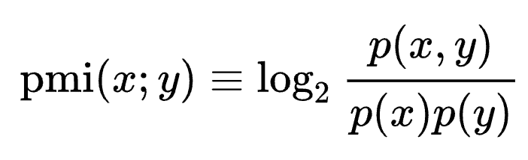
Word Embeddings: Pointwise Mutual Information
In estimating latent representations that give us co-occurrence information, we tap into mutual information
Pointwise mutual information between two events x and y:
Ratio of the likelihood that (x, y) co-occur to the likelihood that they occur independently
PMI(monte; cristo)?
PMI(the; a)?
https://en.wikipedia.org/wiki/Pointwise_mutual_information

Slide 65
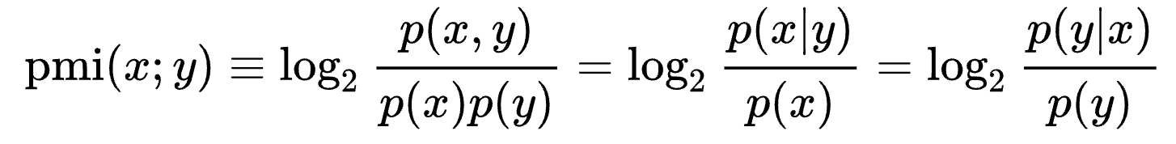
Word Embeddings: Pointwise Mutual Information
What do these PMI formulations start to look like?
Estimate of most likely context given a target word:
argmax_{w(i-k)∊V}(p(w_{i-1}w_{i-2}…w_{i-n+1}|a) / p(w_{i-1}w_{i-2}…w_{i-n+1}))
p(w_{i-1}w_{i-2}…w_{i-n+1}|a) -> co-occurrence of context and target
p(w_{i-1}w_{i-2}…w_{i-n+1}) -> likelihood of context independently
Estimate of the most likely target word given a context:
argmax_{a∊V}(p(a|w_{i-1}w_{i-2}…w_{i-n+1}) / p(a))
Co-occ of a and context over independent likelihood of a
https://en.wikipedia.org/wiki/Pointwise_mutual_information

Slide 66
NLP FUNDAMENTALS: Word Embeddings
A word embedding is a vector representation of a word
Word embeddings can be learned for specific tasks (e.g., our book classification task) or from self-supervised objectives
“You shall know a word by the company it keeps” - Firth
The guiding principle of many learned word embeddings is that two words who share similar context should have embeddings that are close together in vector space
Word embedding learning algorithms estimate PMI between words and one another (their “company”)
J.R. Firth. A synopsis of linguistic theory. Studies in linguistic analysis, Blackwell, Oxford (1957)

Slide 67
Contextual Word Embeddings
Consider the word vectors in the following sentences:
x = {“she launched into a bass solo”, “the line went taut as the bass pulled”; “the power of the bass broke the string”}
Many words have multiple senses, or meanings; even worse for BPE tokens!
Polysemy is a key weakness of so-called lexical embeddings
We can instead learn a function that combines input lexical embeddings from each word to produce output contextual embeddings that consider surrounding words

Slide 68
Contextual Word Embeddings
<S> | i’m happy today <E> ;
i’m | <S>; happy today <E>
happy | <S> i’m ; today <E>
today | <S> i’m happy ; <E>
<E> | ; <S> i’m happy today
← Contextual Embeddings
Fully Connected Layer
…
…
…
…
…
Fully Connected Layer
← Lexical Embeddings
Embedding Layer V_{e}(t)
999
320
253
780
998
<S>
i’m
happy
today
<E>

Slide 69
Overview of Today’s Plan
Course organization and deliverables
Recap from Lecture 5
Language Models and Word Embeddings
Any questions before we move on?
Project Pitches

Slide 70
Action Items for You
Your project surveys are due next week on Friday [Mar 10]
Next week we will release Coding Assignment 2 [Mar 10]
Two weeks from today there will be no class [March 17]

Slide 71
CSCI 566: Deep Learning and Its Applications
Jesse Thomason
Lecture 6: DL for Natural Language Processing

